Slide 1
This file contains the source images for the circular prompts used by the Grasp.exe program.
See GraspBMP.mak for instructions on how to convert this file into the .bmp files needed by the program.

Slide 2
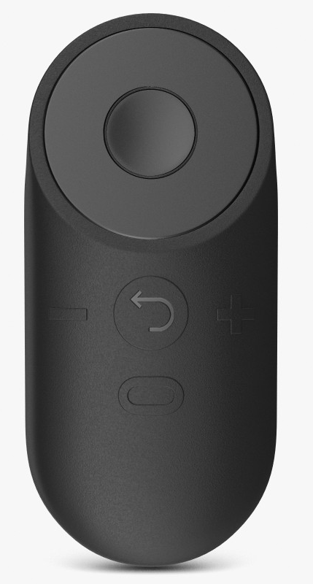
Ready to start next trial.
Press Select to continue.

Slide 3
Trial block completed.
Click Select to exit. Press and hold Return to continue.

Slide 4
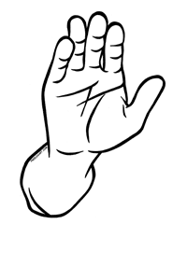
Lower Hand Lower Hand

Slide 5
Time to lower hand exceeded.
Press Select to continue.

Slide 6
Raise hand and aim at target.

Slide 7
Time to raise hand exceeded.
Press Select to continue.

Slide 8
Head t ilt not maintained.
Press Select to continue.

Slide 9
Time to t ilt head exceeded.
Press Select to continue.

Slide 10
Time to respond exceeded.
Press Select to continue.

Slide 11
Time limit exceeded.
Press Select to continue.

Slide 12
Time to rotate hand exceeded.
Press Select to continue.

Slide 13
Hand raised too soon.
Press Select to continue.

Slide 14
Hand should not be raised.
Press Select to continue.

Slide 15
Straighten head on shoulders.
When head is straigth, press Select to continue.

Slide 16
VR activity completed.
Doff Virtual Reality Helmet and press Return.

Slide 17
VR appears to be working.
Press Return to cont inue.

Slide 18
Trial voluntarily aborted.
Press Select to continue.

Slide 19
Previous response invalidated.
Press Select to continue.

